Slide 1
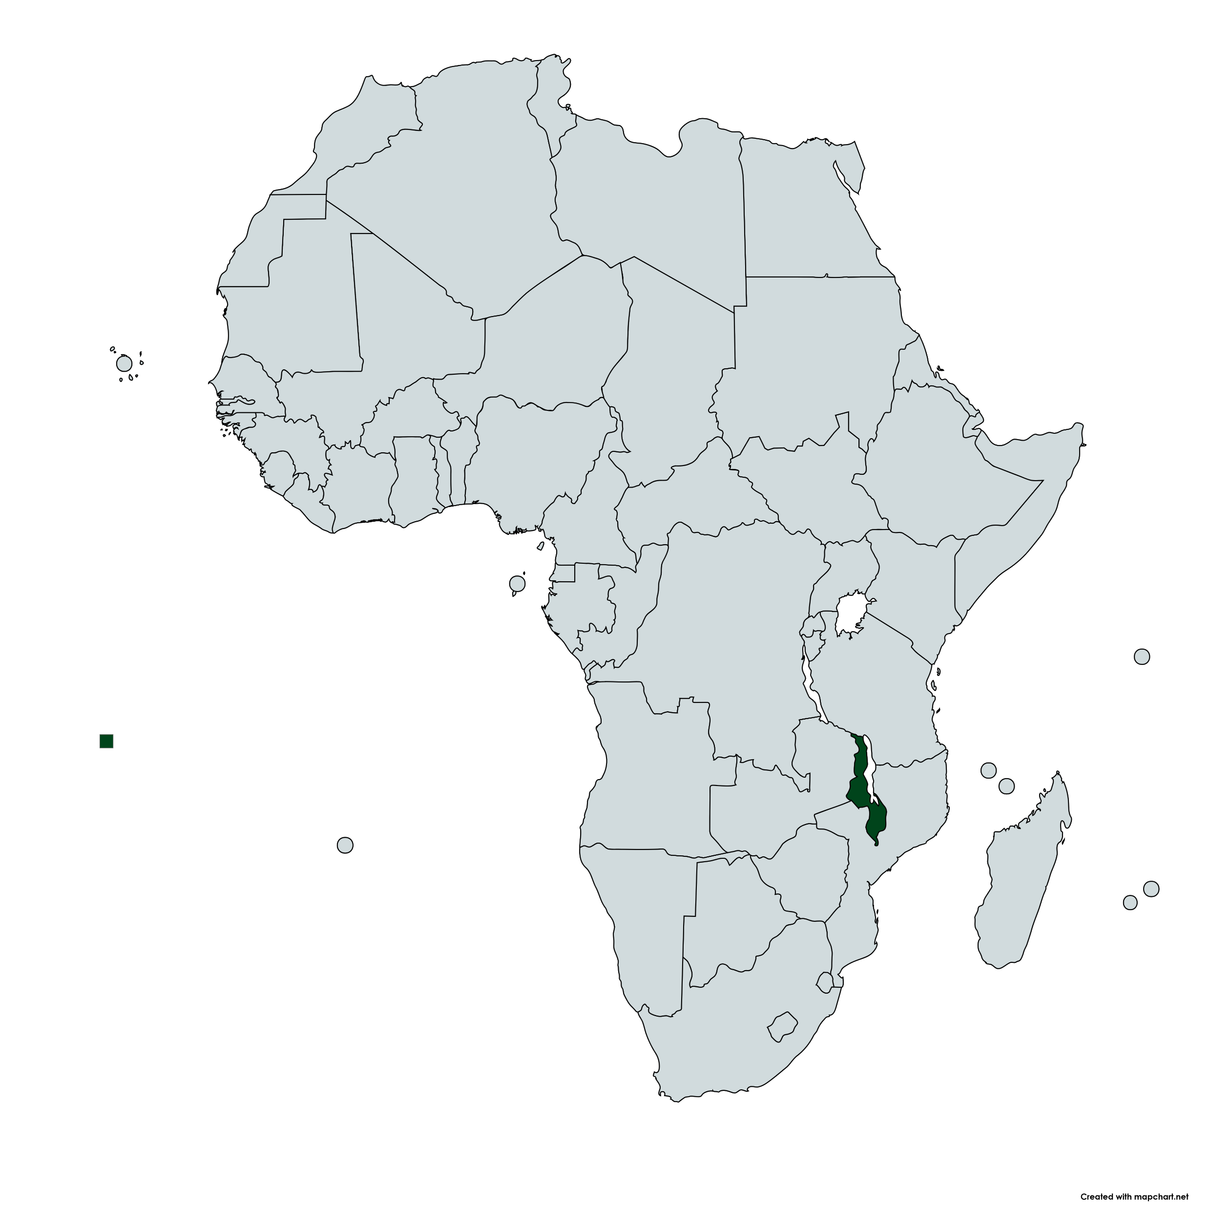
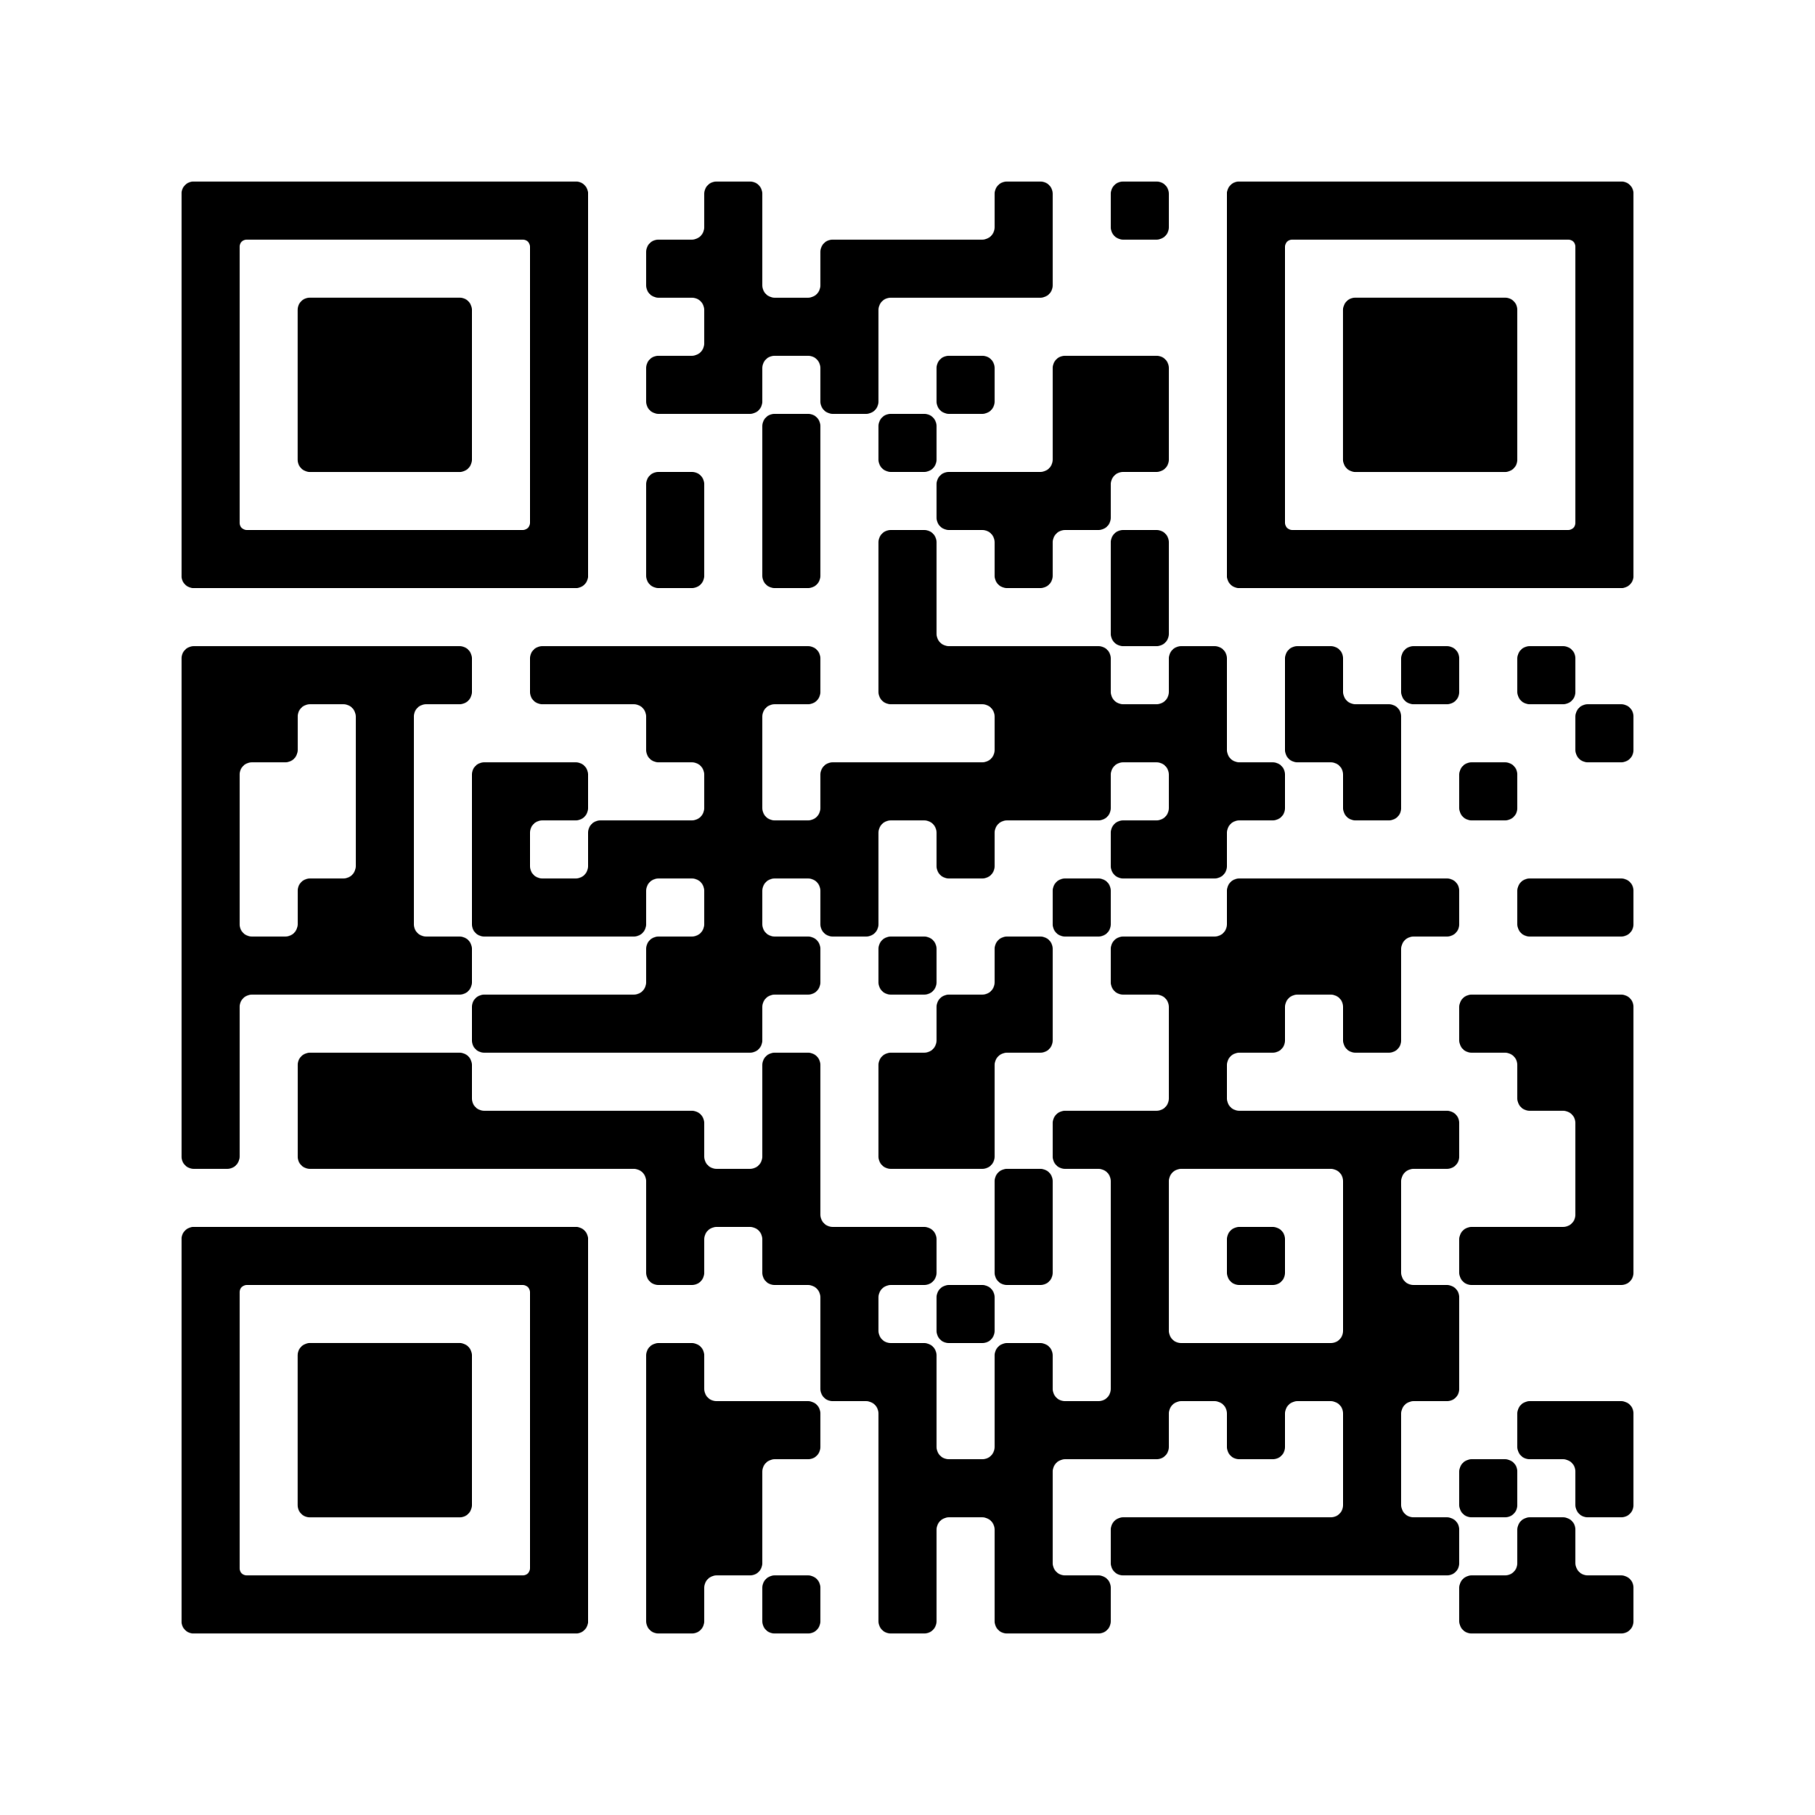
WHEN YOUTH SPEAK, DO BUDGETS LISTEN?
EVIDENCE FROM MALAWI
AUBREY GHAMBI, MASTER OF PUBLIC POLICY PROGRAM, MICHIGAN STATE UNIVERSITY
Youth Priorities (18–24, 2020 → 2024)
Education ↑
Job training (skills) ↑
Job creation ↓
Business loans ↓
Do government budgets in Malawi reflect youth priorities?
Youth priorities and youth policies align around education, skills, jobs,
and access to business loans.
Government spending is less aligned: education dominates, while jobs,
loans, and skills training remain underfunded.
Secondary education improved, but post-secondary completion and
stable employment remain limited.
Secondary improves, Post-Secondary stagnates
Malawi’s national development plan (Malawi 2063) places youth at the center of economic transformation. In a country where over half the population is under 18, many young people still lack jobs, skills, and business support. Misaligned spending slows progress toward this goal.
Older Youth focus on loans, Younger on education
POLICY RECOMMENDATIONS
Set a minimum funding target for youth economic programs beyond education to reflect youth demand.
Improve coordination across Education, Youth, Labor, and Finance ministries.
Pilot district coordinators and a youth dashboard to monitor and track programs.
The study Examines youth priorities, policy goals, and national budgets (2020–2024).
Data sources:
Afrobarometer surveys (2020–2024)
Youth Policies (2013; 2023– 2028)
Malawi National budgets (2020–2024)
Education dominates Youth program spending
Youth priorities differ by age: younger youth focus on education, while older youth emphasize income and business support. But budgets remain concentrated in education.
ACKNOWLEDGMENTS: PROFESSOR MARTY P. JORDAN AND DR. CAROLYN LOGAN

